Slide 1
Parking Replacement Options

Slide 2
WARNING: WORKING DRAFT DESIGNS
It is important to note all of the following images and parking plans will need final approvals and final design / engineering work.

Slide 3
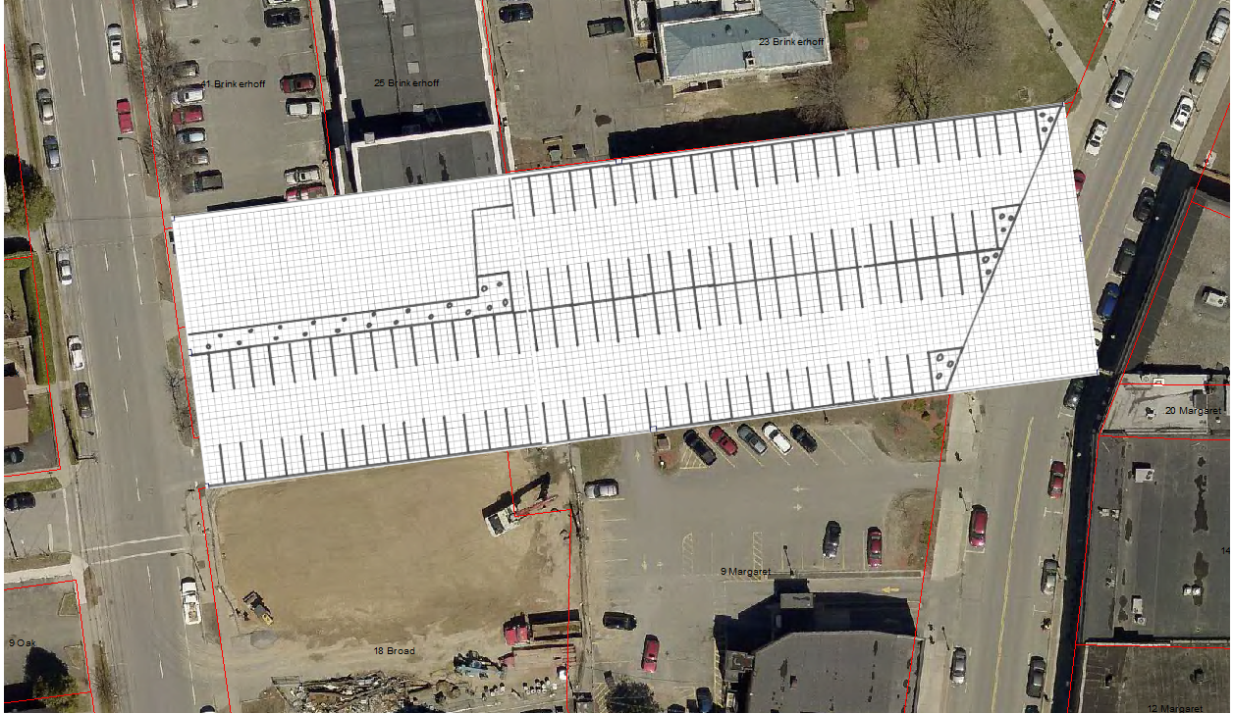
Glens Falls Lot
+115 spaces
24 feet driving lanes which could allow 2 way traffic.
Exit built in for Community Bank Customers.

Slide 4
Parking Replacement Space Tally
Option:
Glens Falls Lot: 115 spaces
115 Spaces

Slide 5
Clinton County Parking Reconfiguration
+70 Spots
The County is looking to reconfigure their existing parking lots (Main Campus / Oak Street) which is expected to increase parking capacity by 70 spots.
This parking will reduce the demand on the surrounding streets and lots from County employees / visitors / jurors. The parking will also benefit the City for special events and evening parking supply.

Slide 6
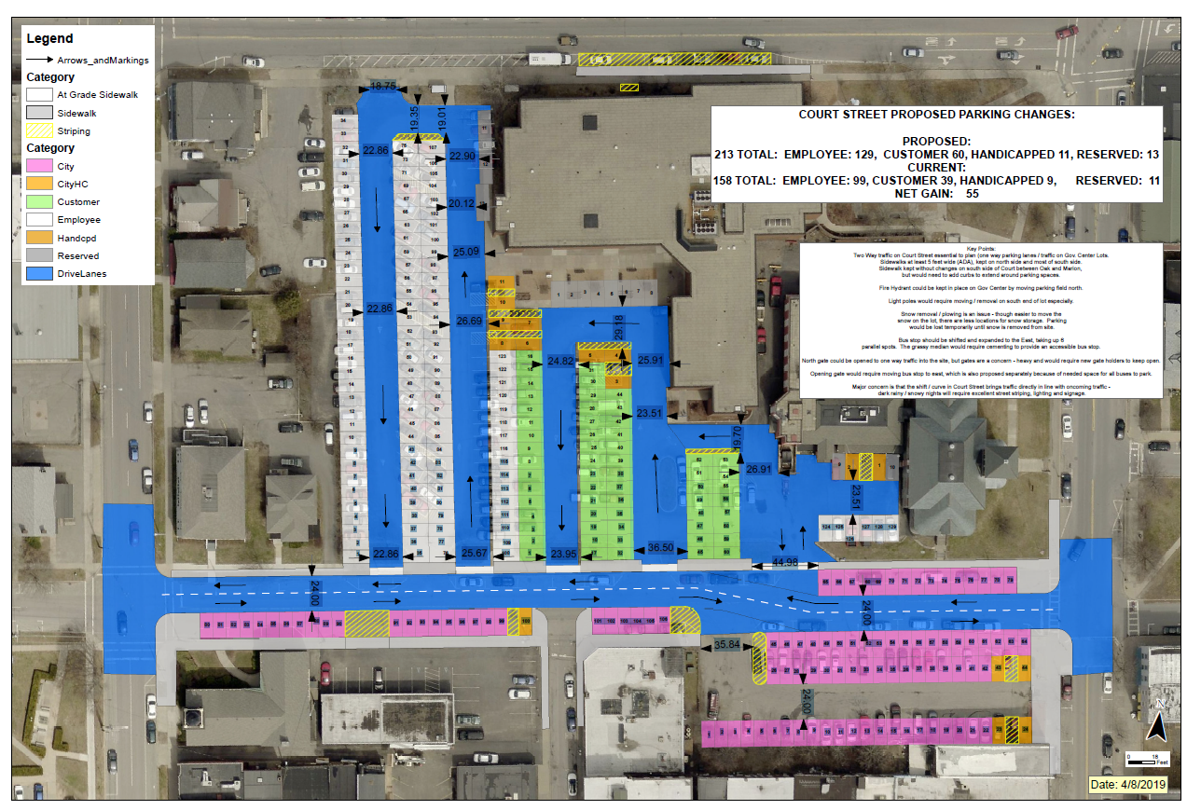

Slide 7
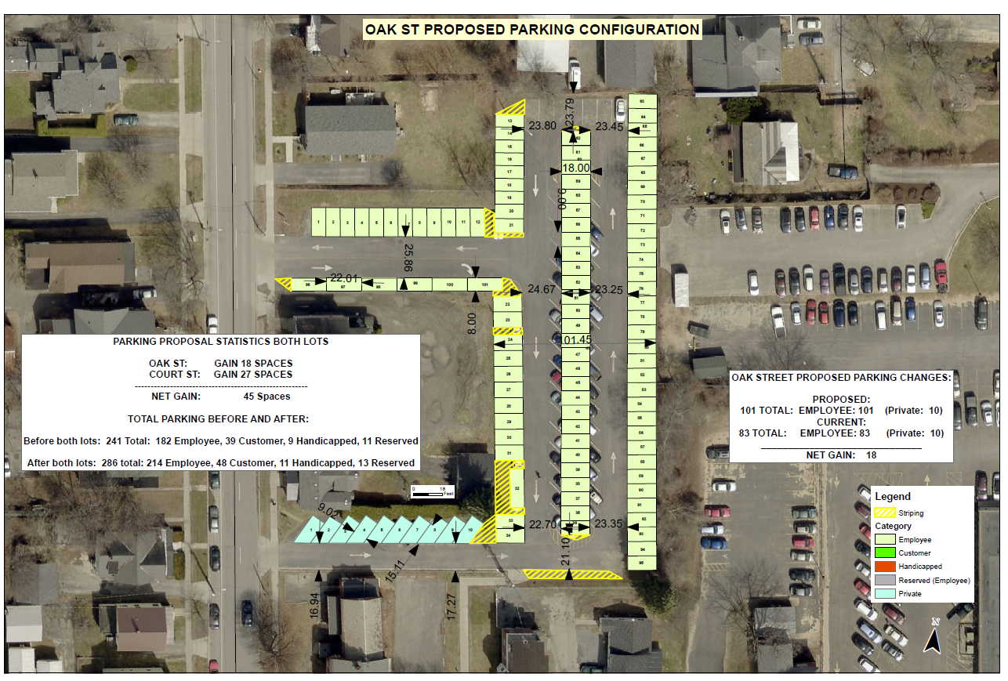

Slide 8
Parking Replacement Space Tally
Options:
Glens Falls Lot: 115 spaces
Clinton County Parking Lot Adjustments: 70 spaces
185 Spaces

Slide 9
Court Street Reconfiguration
+34 Spaces
In the model shown earlier this section of Court Street would behave much more like a parking lot than a street.
Traffic calming measures could be implemented
Reduced Speed Limit
Seasonal Speed Bumps
Stop Signs
The current model is built with 24 feet driving lanes could allow for possibility for 2-way traffic.

Slide 10
Parking Replacement Space Tally
Options:
Glens Falls Lot: 115 spaces
Clinton County Parking Lot Adjustments: 70 spaces
Court Street Reconfiguration: 34 spaces
219 Spaces

Slide 11
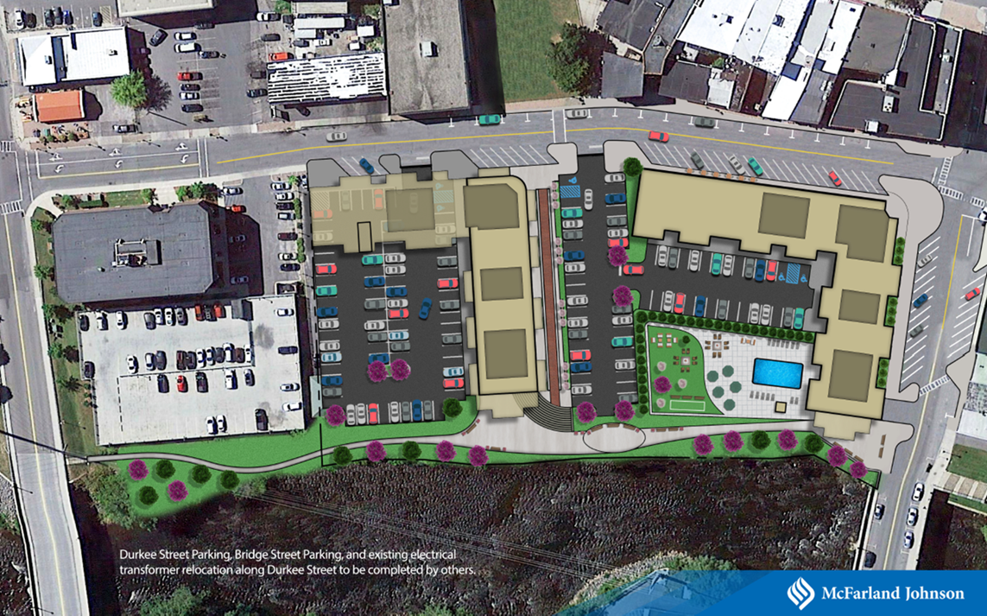
Durkee Street Development
+30 Spots
The current language in the Development Agreement with Prime Companies has set aside 30 spaces for public use.

Slide 12
Parking Replacement Space Tally
Options:
Glens Falls Lot: 115 spaces
Clinton County Parking Lot Adjustments: 70 spaces
Court Street Reconfiguration: 34 spaces
Durkee Street Development: 30 spaces
249 Spaces

Slide 13
Durkee Street Development – On Street
+29 Spaces
Prime Companies original design had the creation of up to 36 more spots on Durkee Street. However, this did not anticipate the electrical transformers staying. This would lose roughly 13 spots. Their design also did not include the option of adding any parking farther down Durkee Street past their development, which can add around 6 spots.
Preliminary design work for the Durkee Street Development is in progress.

Slide 14
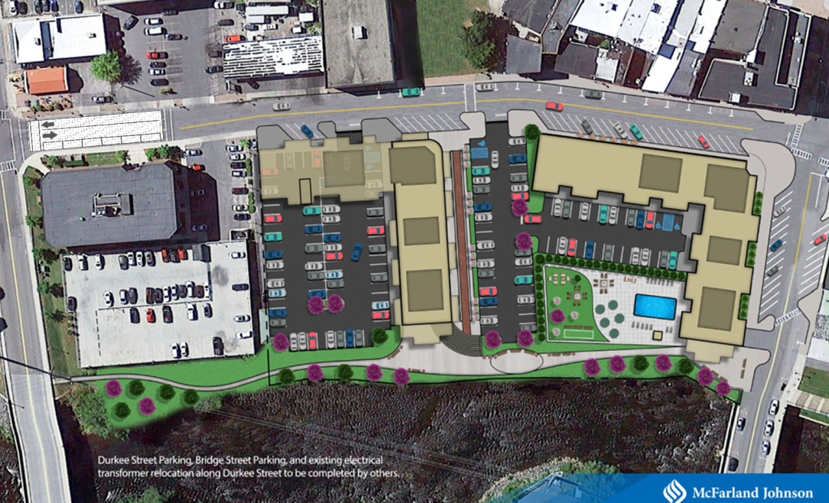

Slide 15
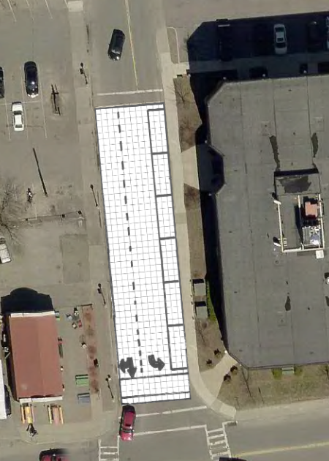
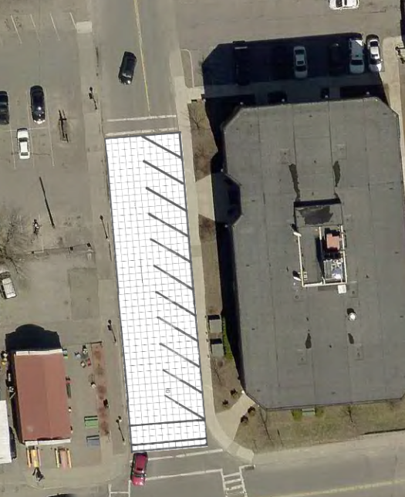
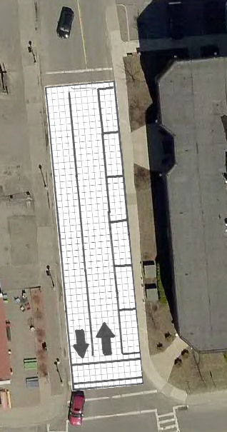

Slide 16
Parking Replacement Space Tally
Options:
Glens Falls Lot: 115 spaces
Clinton County Parking Lot Adjustments: 70 spaces
Court Street Reconfiguration: 34 spaces
Durkee Street Development “On-Site”: 30 spaces
Durkee Street Reconfiguration: 29 spaces
278 Spaces

Slide 17
Brinkerhoff Street Reconfiguration
+11 Spaces
Previously discussed this would turn this section of Brinkerhoff into a one-way, one-lane street.
Would have a combination of parallel parking and 45 degree angled parking
Driving Lane would fluctuate between 12 feet – 18 feet.
Traffic Calming Measures can be taken if necessary as well.

Slide 18
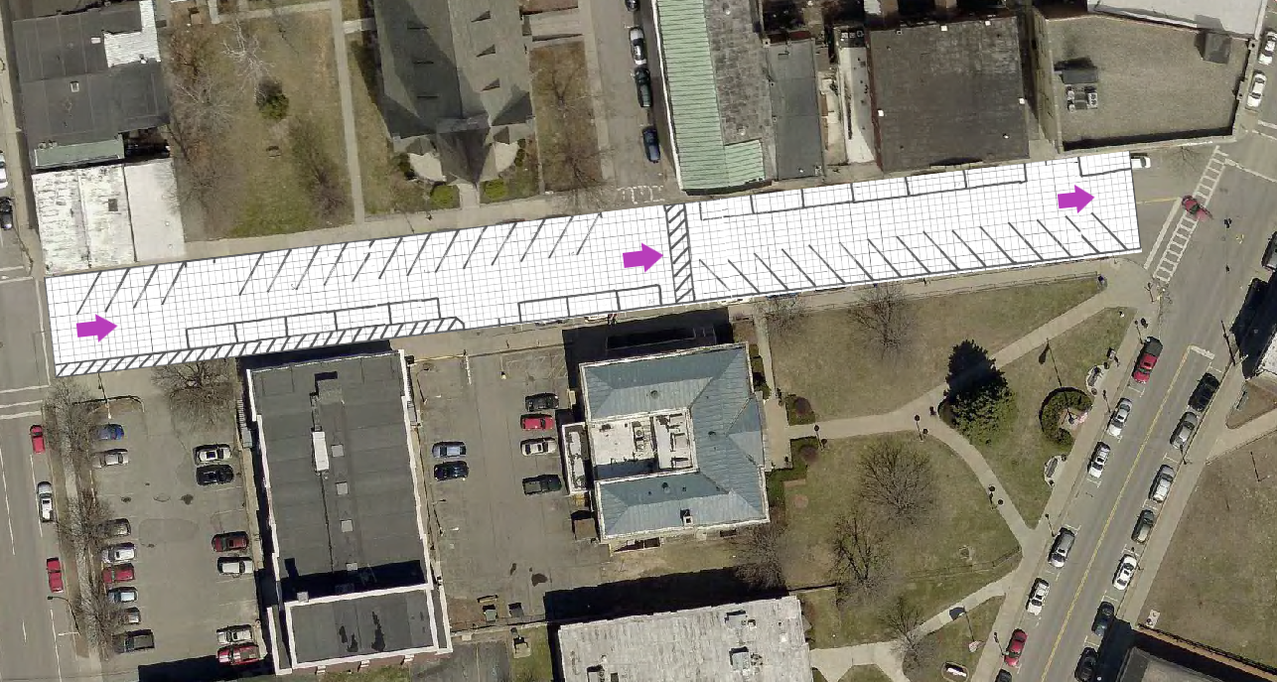

Slide 19
Parking Replacement Space Tally
Options:
Glens Falls Lot: 115 spaces
Clinton County Parking Lot Adjustments: 70 spaces
Court Street Reconfiguration: 34 spaces
Durkee Street Development “On-Site”: 30 spaces
Durkee Street Reconfiguration: 29 spaces
Brinkerhoff Street Reconfiguration: 11 spaces
289 Spaces

Slide 20
Angled Parking
One of the conversations our committee has had is weighing the pros and cons of angled parking.
In this current update only the section of Brinkerhoff Street & Durkee Street incorporate angled parking. It should be noted that only 34 spots, or around 12% of the currently proposed parking replacement options is angled parking.
However, more angled parking is not off the table if needed.
34/289= 11.8%

Slide 21
Additional Parking Capacity
Further examples of potential additional parking capacity can be found below. Depending on any alterations to the parking replacement working drafts there are a few different avenues for the PPAC and the City to pursue.
Along with the replacement parking, the move to a managed parking system allows the ability to better manage the parking resources we currently have.

Slide 22
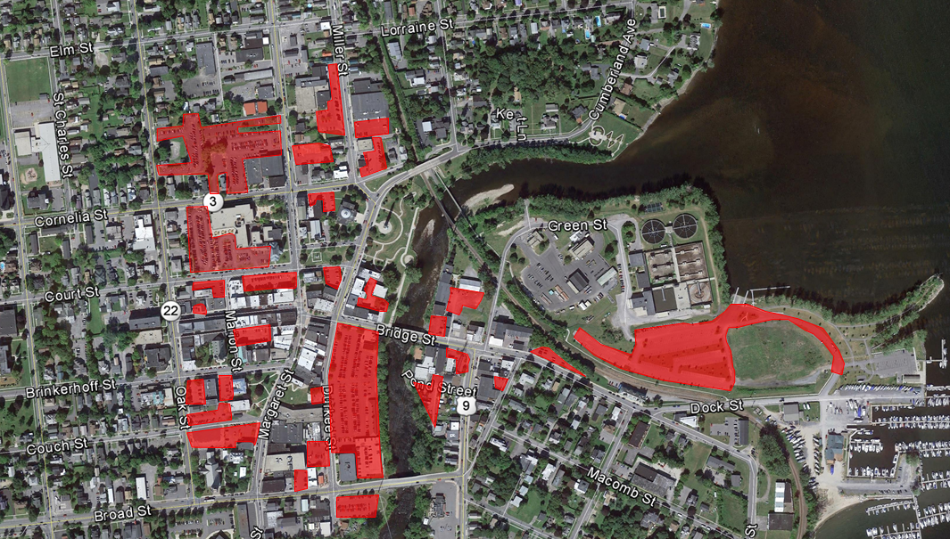

Slide 23
Community Bank Shared-Use Agreement
A shared-use agreement with Community Bank would allow for public parking on their site. In turn the City would provide parking signage and enforcement.
Discussions with Community Bank are ongoing.

Slide 24
Private Lot Shared-Use Agreements
Similar to a potential shared-use agreement with Community Bank, the City is pursuing shared-use agreements with various private property owners.
The City has had discussions with several owners of private downtown lots.

