Slide 1


Plattsburgh Downtown Parking Study
Study Update – October 2017

Slide 2
Purpose of Study
Engage Community in Parking Discussion
Assess Current Conditions
  Parking Demand
  Patron Service Levels
  Administration of Parking Assets
Consideration of DRI / Durkee St. Lot
Options for Future Flexibility and Service

Slide 3
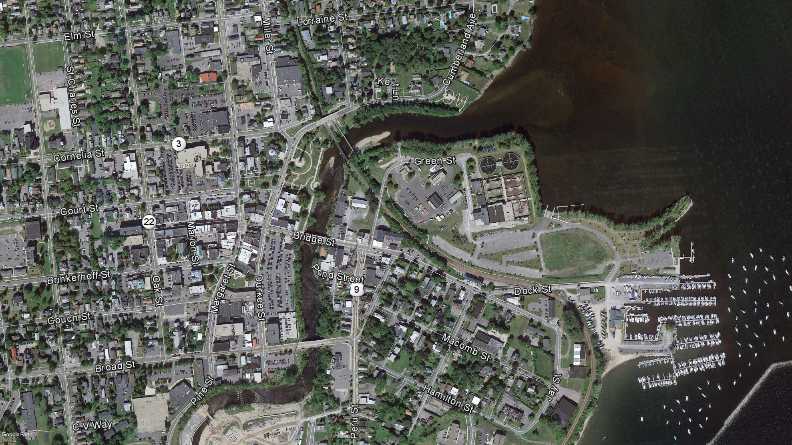
Project Approach & Methodology

Slide 4
Project Approach & Methodology
Data Collection – On and Off-Street Parking
  Inventory Downtown Parking
  Parking Occupancy Counts
    Wednesday, September 20- Workday
    Thursday, September 21 - Workday
    Friday, September 22 - Evening

Slide 5
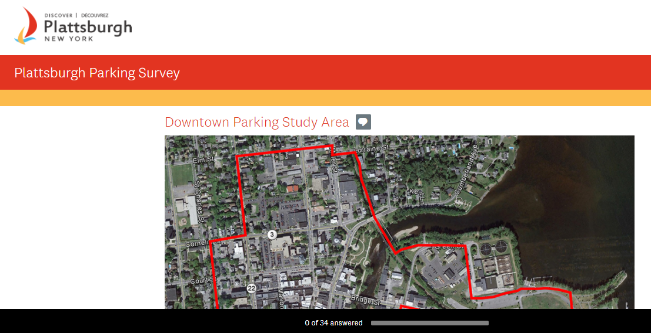
Project Approach & Methodology
Data Collection – Public Input
  Public Survey
  Interviews
    City Staff
    City Department Leads
    Business Owners
  Public Open House

Slide 6
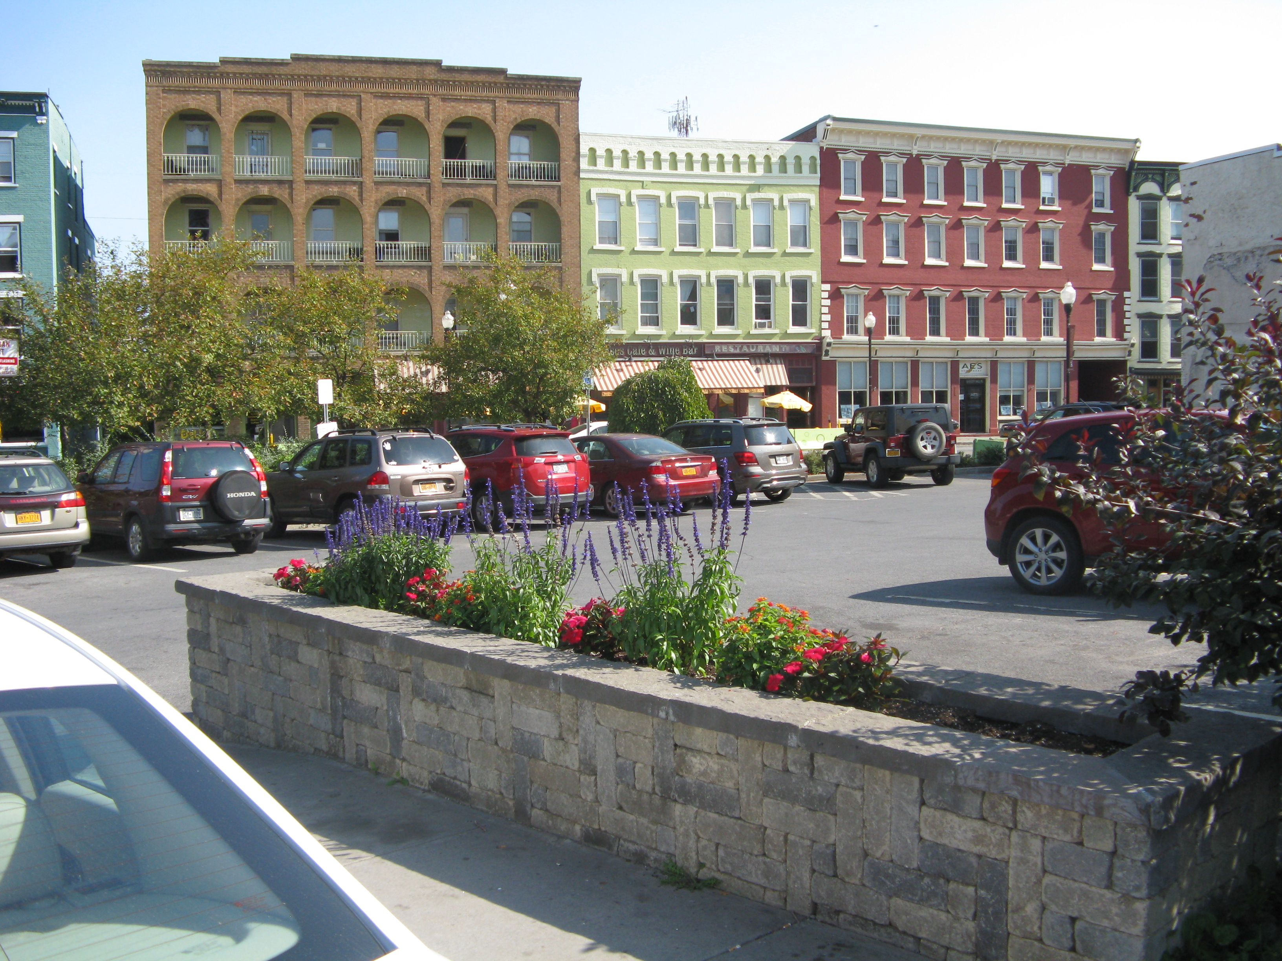
Downtown Parking Supply
Almost 1,200 Off-Street Parking Spaces
  444 in Public Parking Lots
  289 in Durkee St. Lot
677 On-Street Parking Spaces
394 Unused Spaces at Harbor (Not Included)

Slide 7
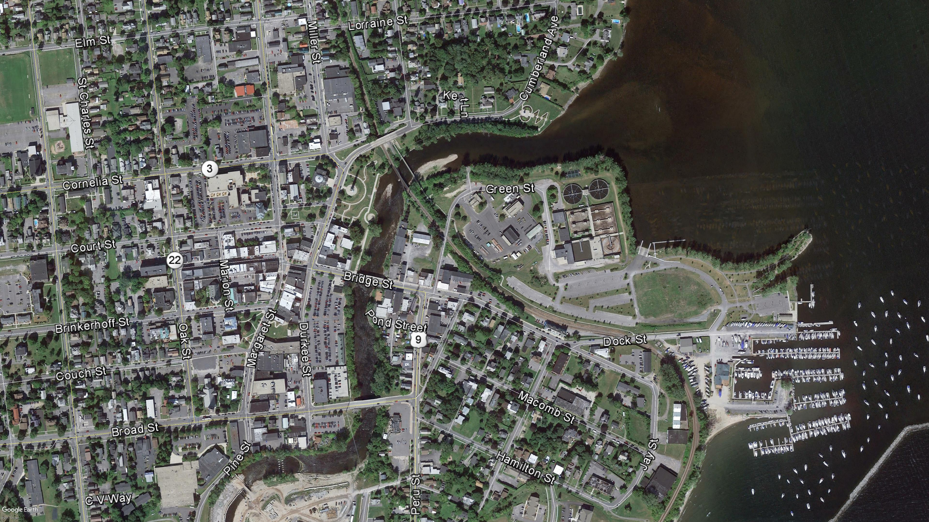
Preliminary Findings

Slide 8
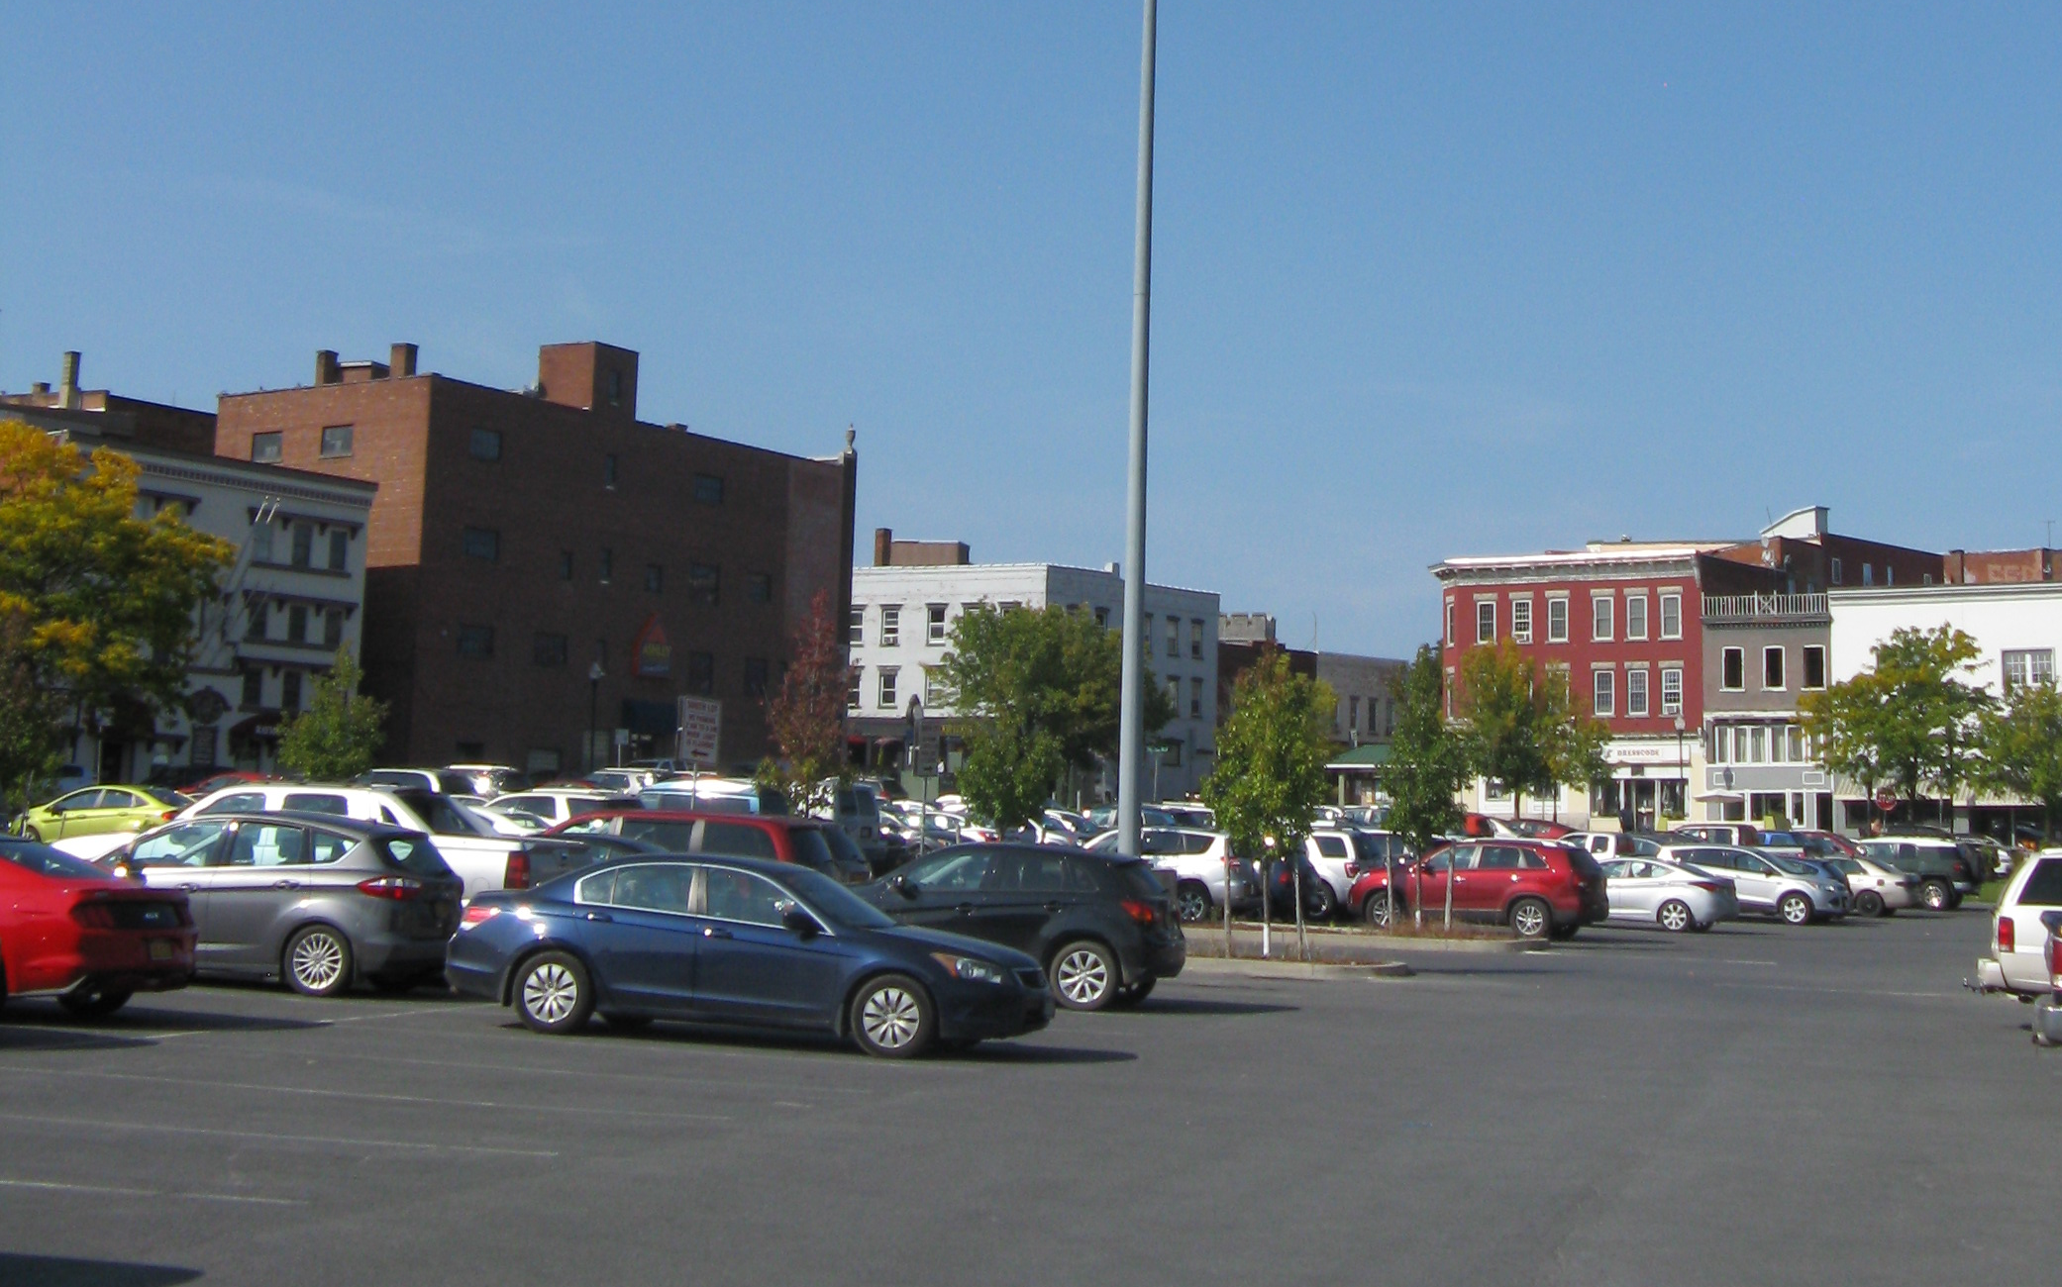
Downtown Parking Demand
Peak Occupancy of City Lots
  85% - Noon (Not Including Bridge St. Lot)
  55% - Evenings
  Margaret and Court – 100%
  Durkee St. – 86%
Can Usually Find A Space in Durkee St. Lot

Slide 9
Downtown Parking Demand
Peak Occupancy of On-Street Parking
  Overall Peak of 62%
  Specific Streets
    Brinkerhoff – 77%
    Clinton – 98%
    Margaret – 82%
Can Usually Find a Space – May Have to Circle Block

Slide 10
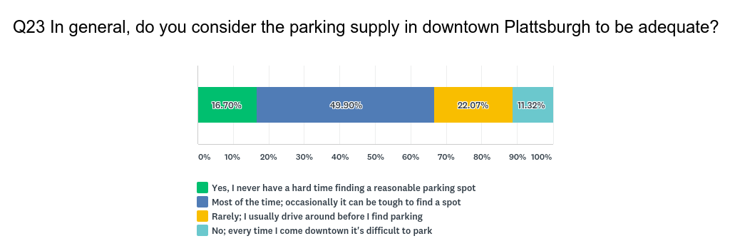
Public Survey

Slide 11
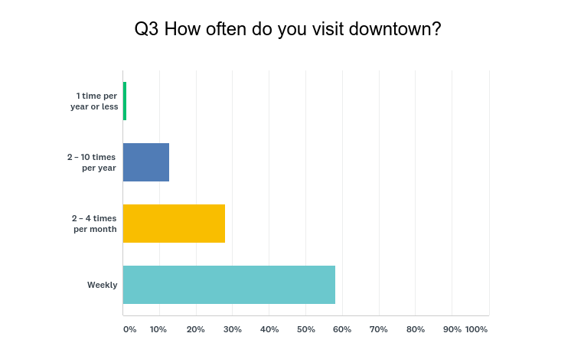
Public Survey

Slide 12
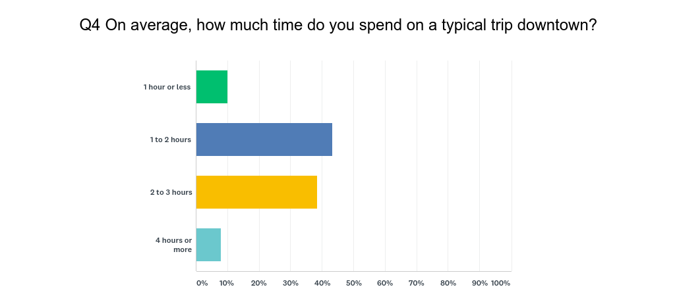
Public Survey

Slide 13
Comparable Cities

Slide 14
Comparable Cities

Slide 15
Comparable Cities

Slide 16
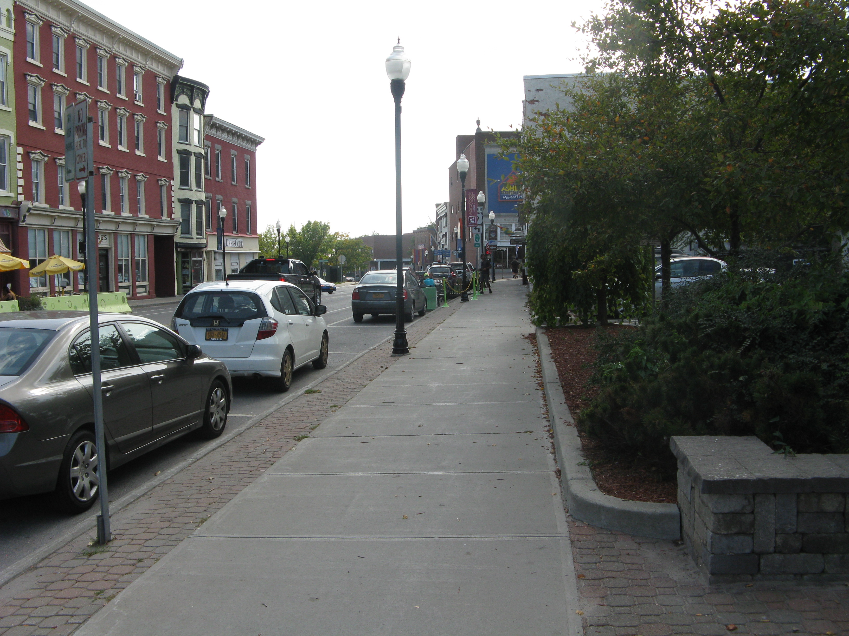
Parking Operations
Free Parking
  Off-Street
    Public
    Private
  On-Street
    Time Limits
    Not Regularly Enforced
  Laissez-Faire System

Slide 17
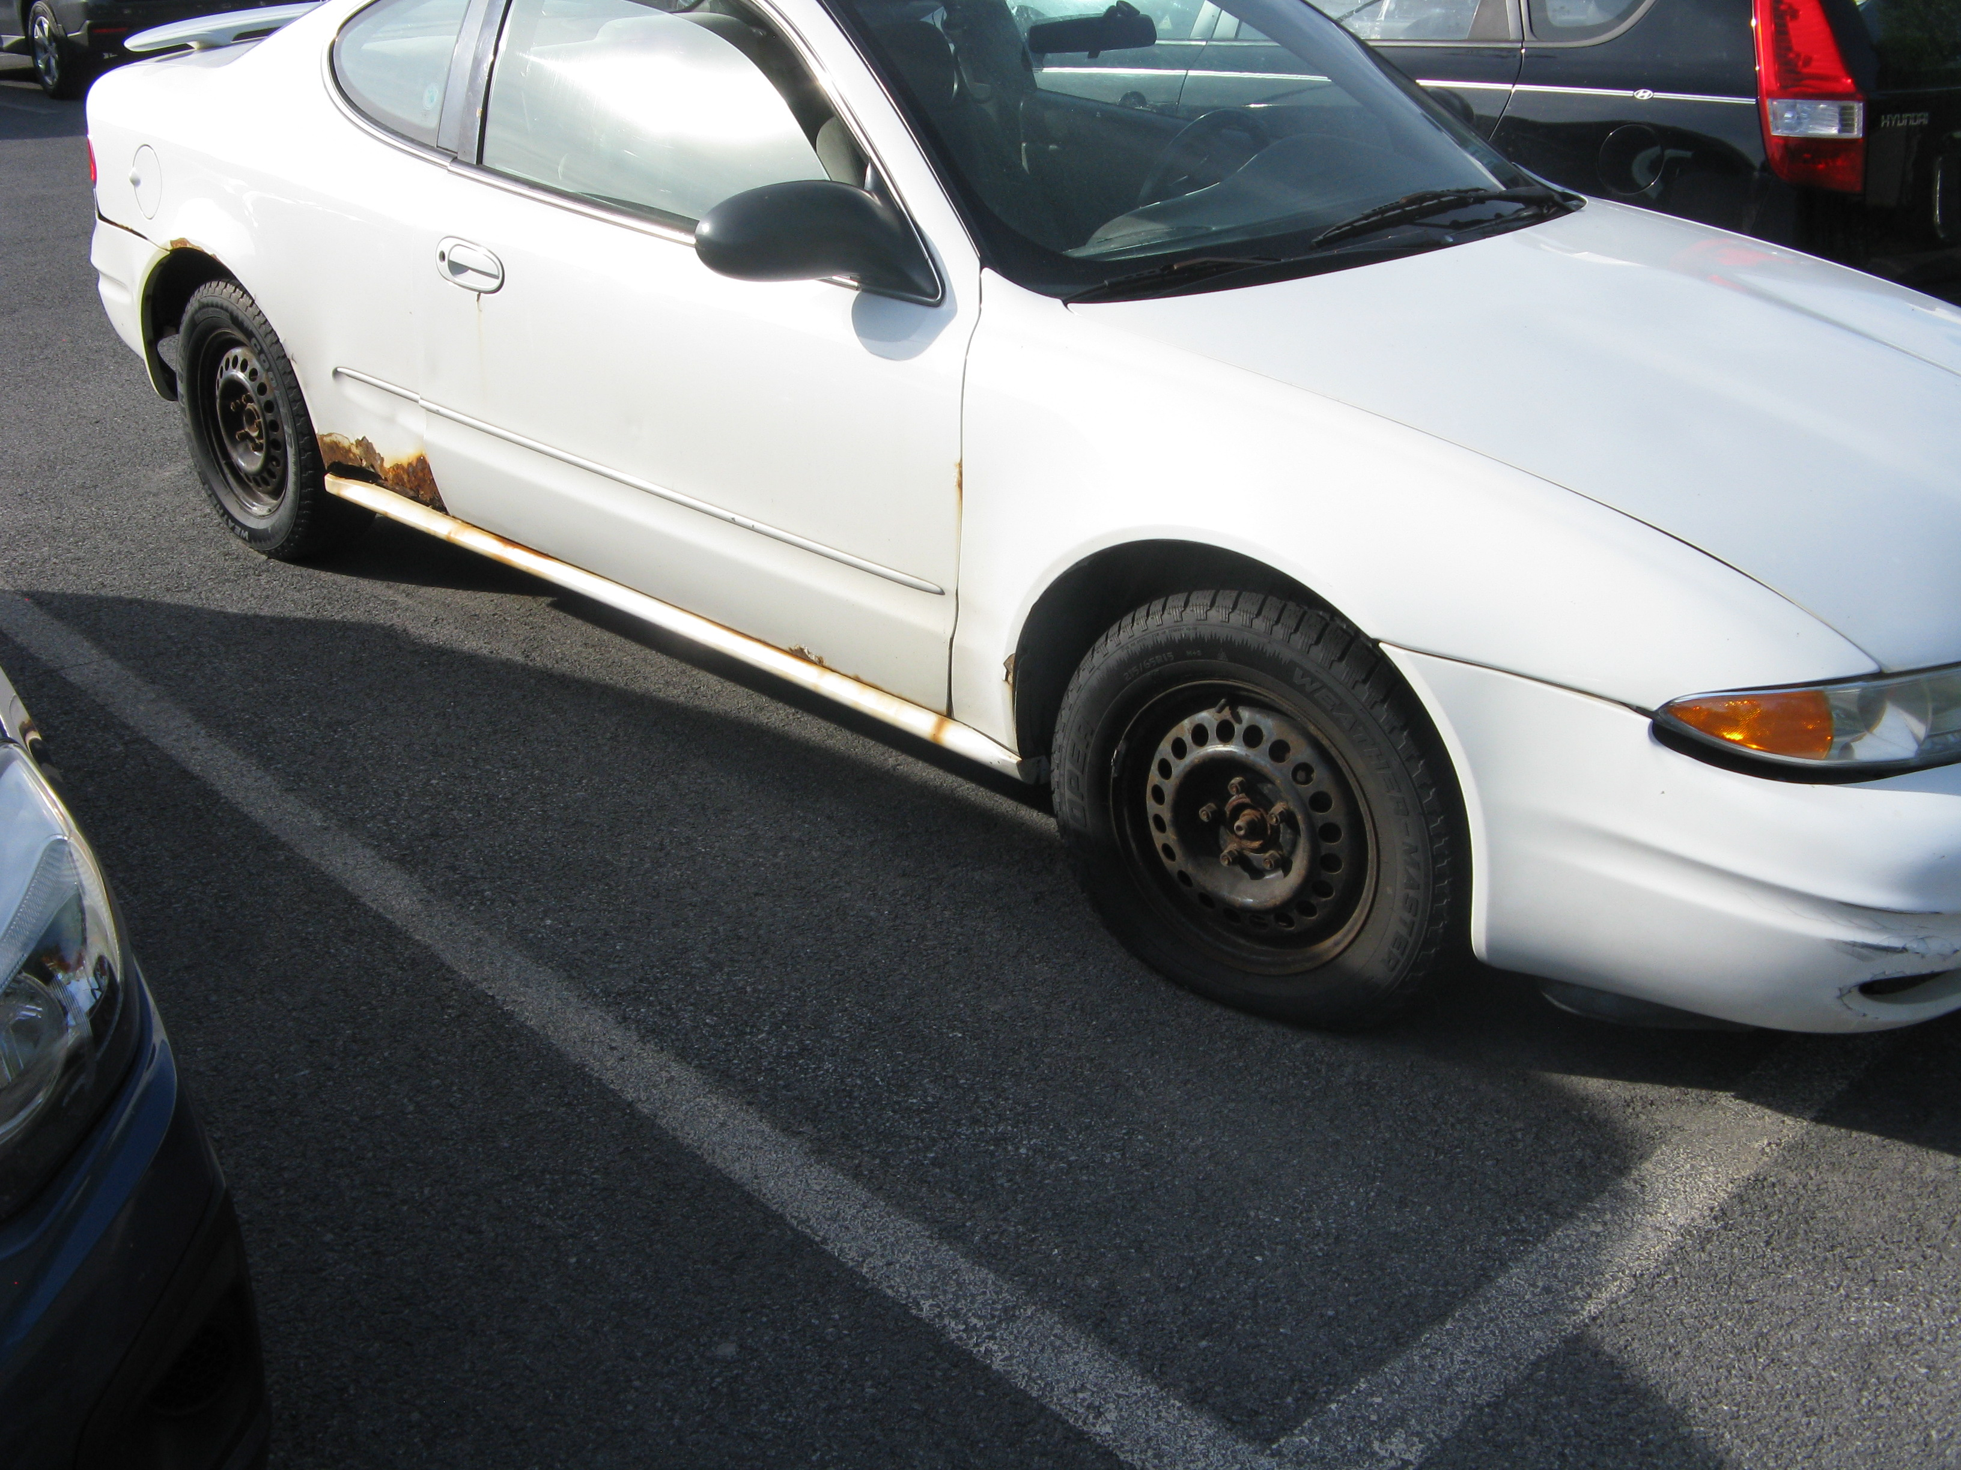
Observations
Providing Parking for Numerous Organizations
  Employers – DSS Estimates 140
  Landlords
Large Amount of Unused Parking at Harbor
Storage Parking In Durkee St. Lot

Slide 18
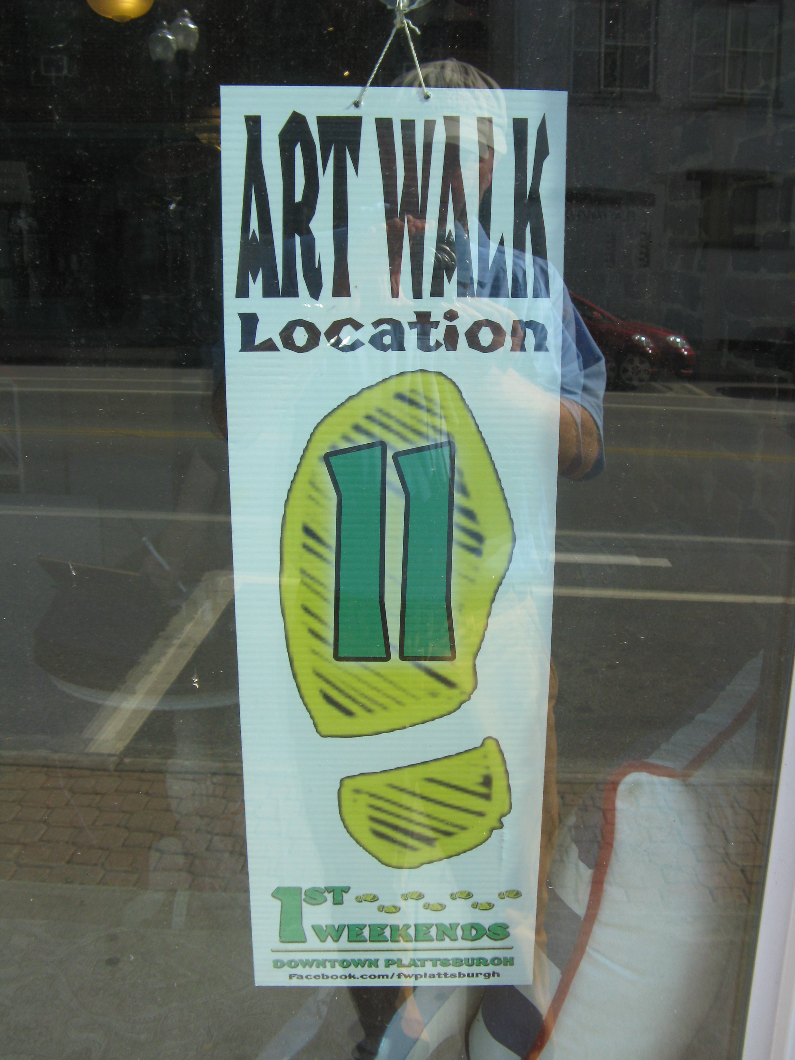
Observations
Downtown Draws
  Strand Theater and Arts Center
  Events
  Food Co-Op
  Restaurants
  Employment Base
Gathering $65,000 from Assessment
  $4.83 per space / month in Revenue
  Non-Profit, Gov’t, Churches Exempted

Slide 19
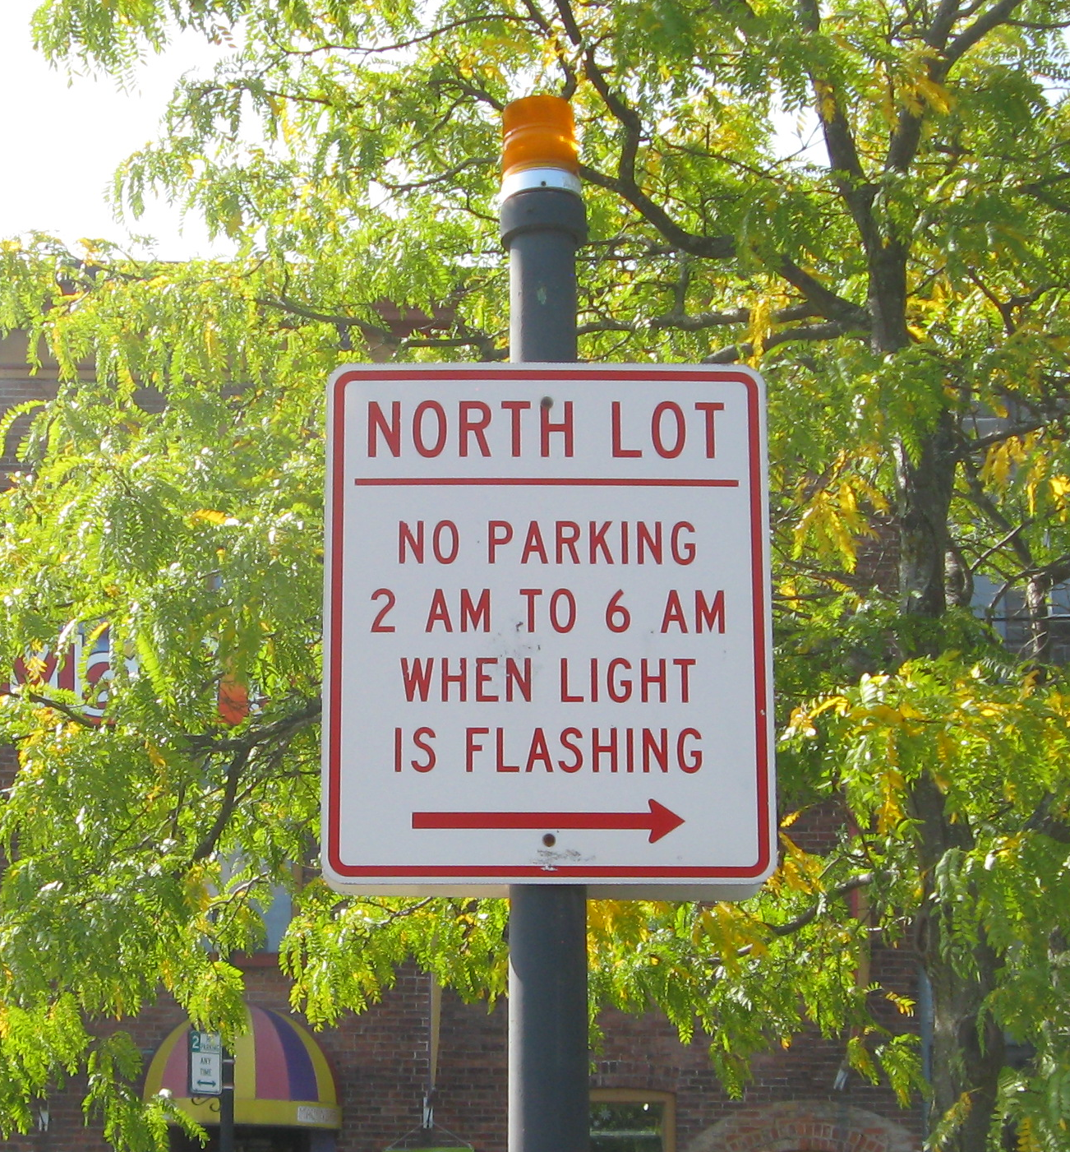
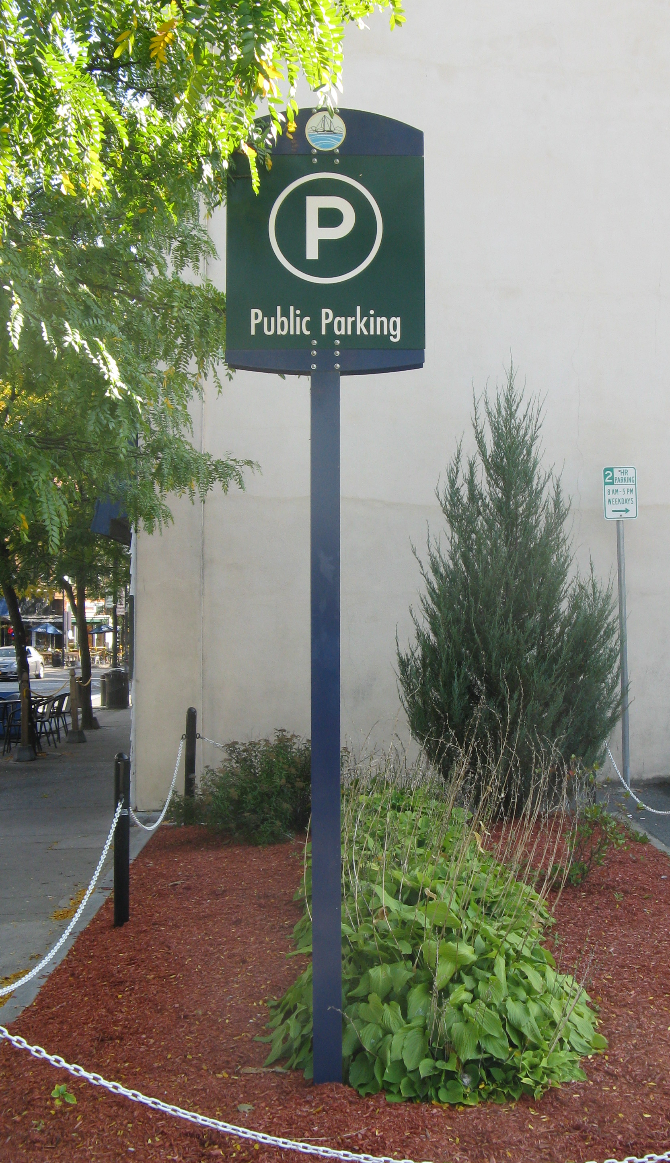
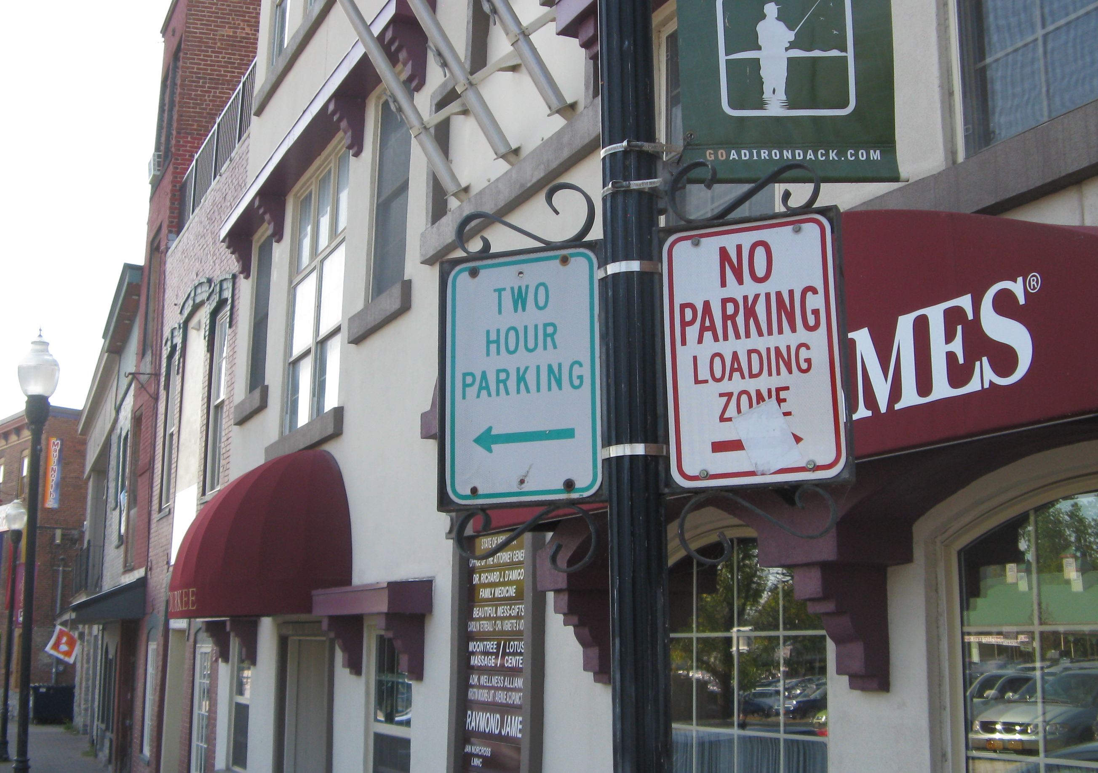
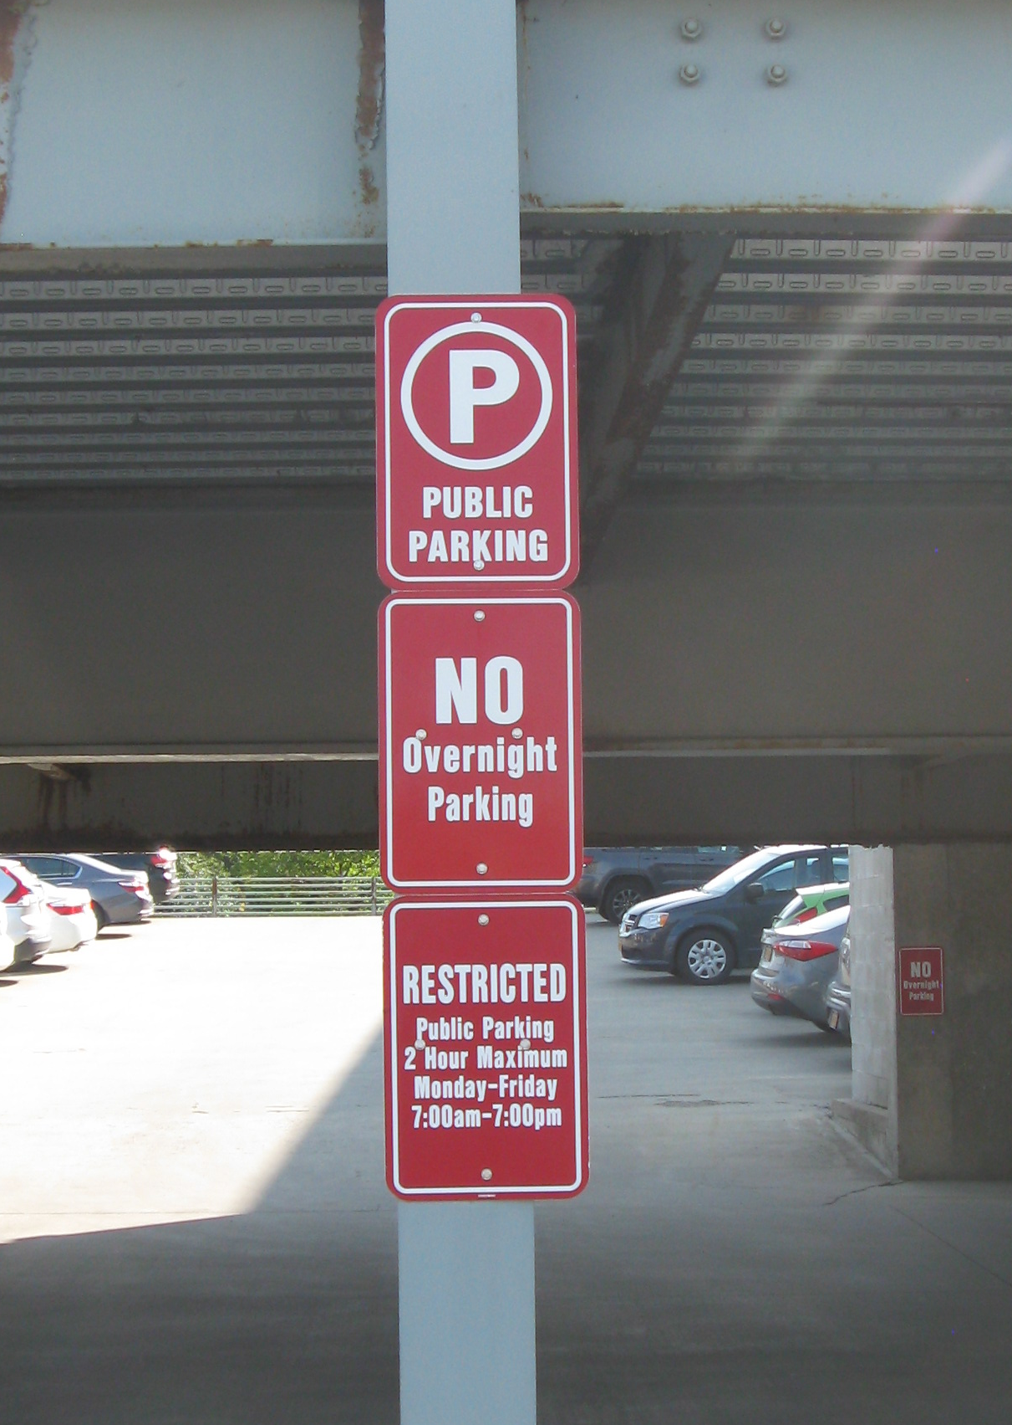
Observations
Good On-Street Parking Signage
Almost No Off-Street Parking Wayfinding

Slide 20
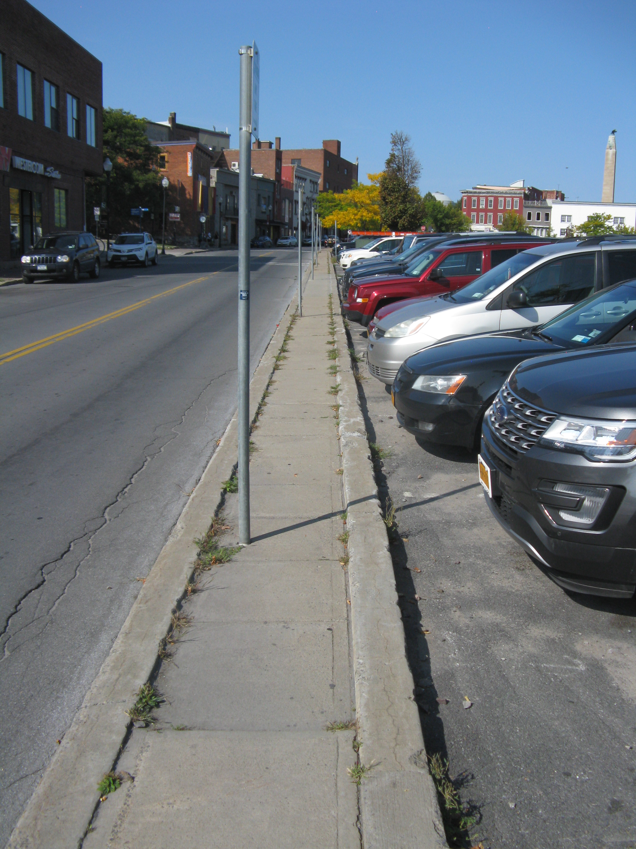
Observations
Generally Good Pedestrian Links
Except Along Durkee St. Lot

Slide 21
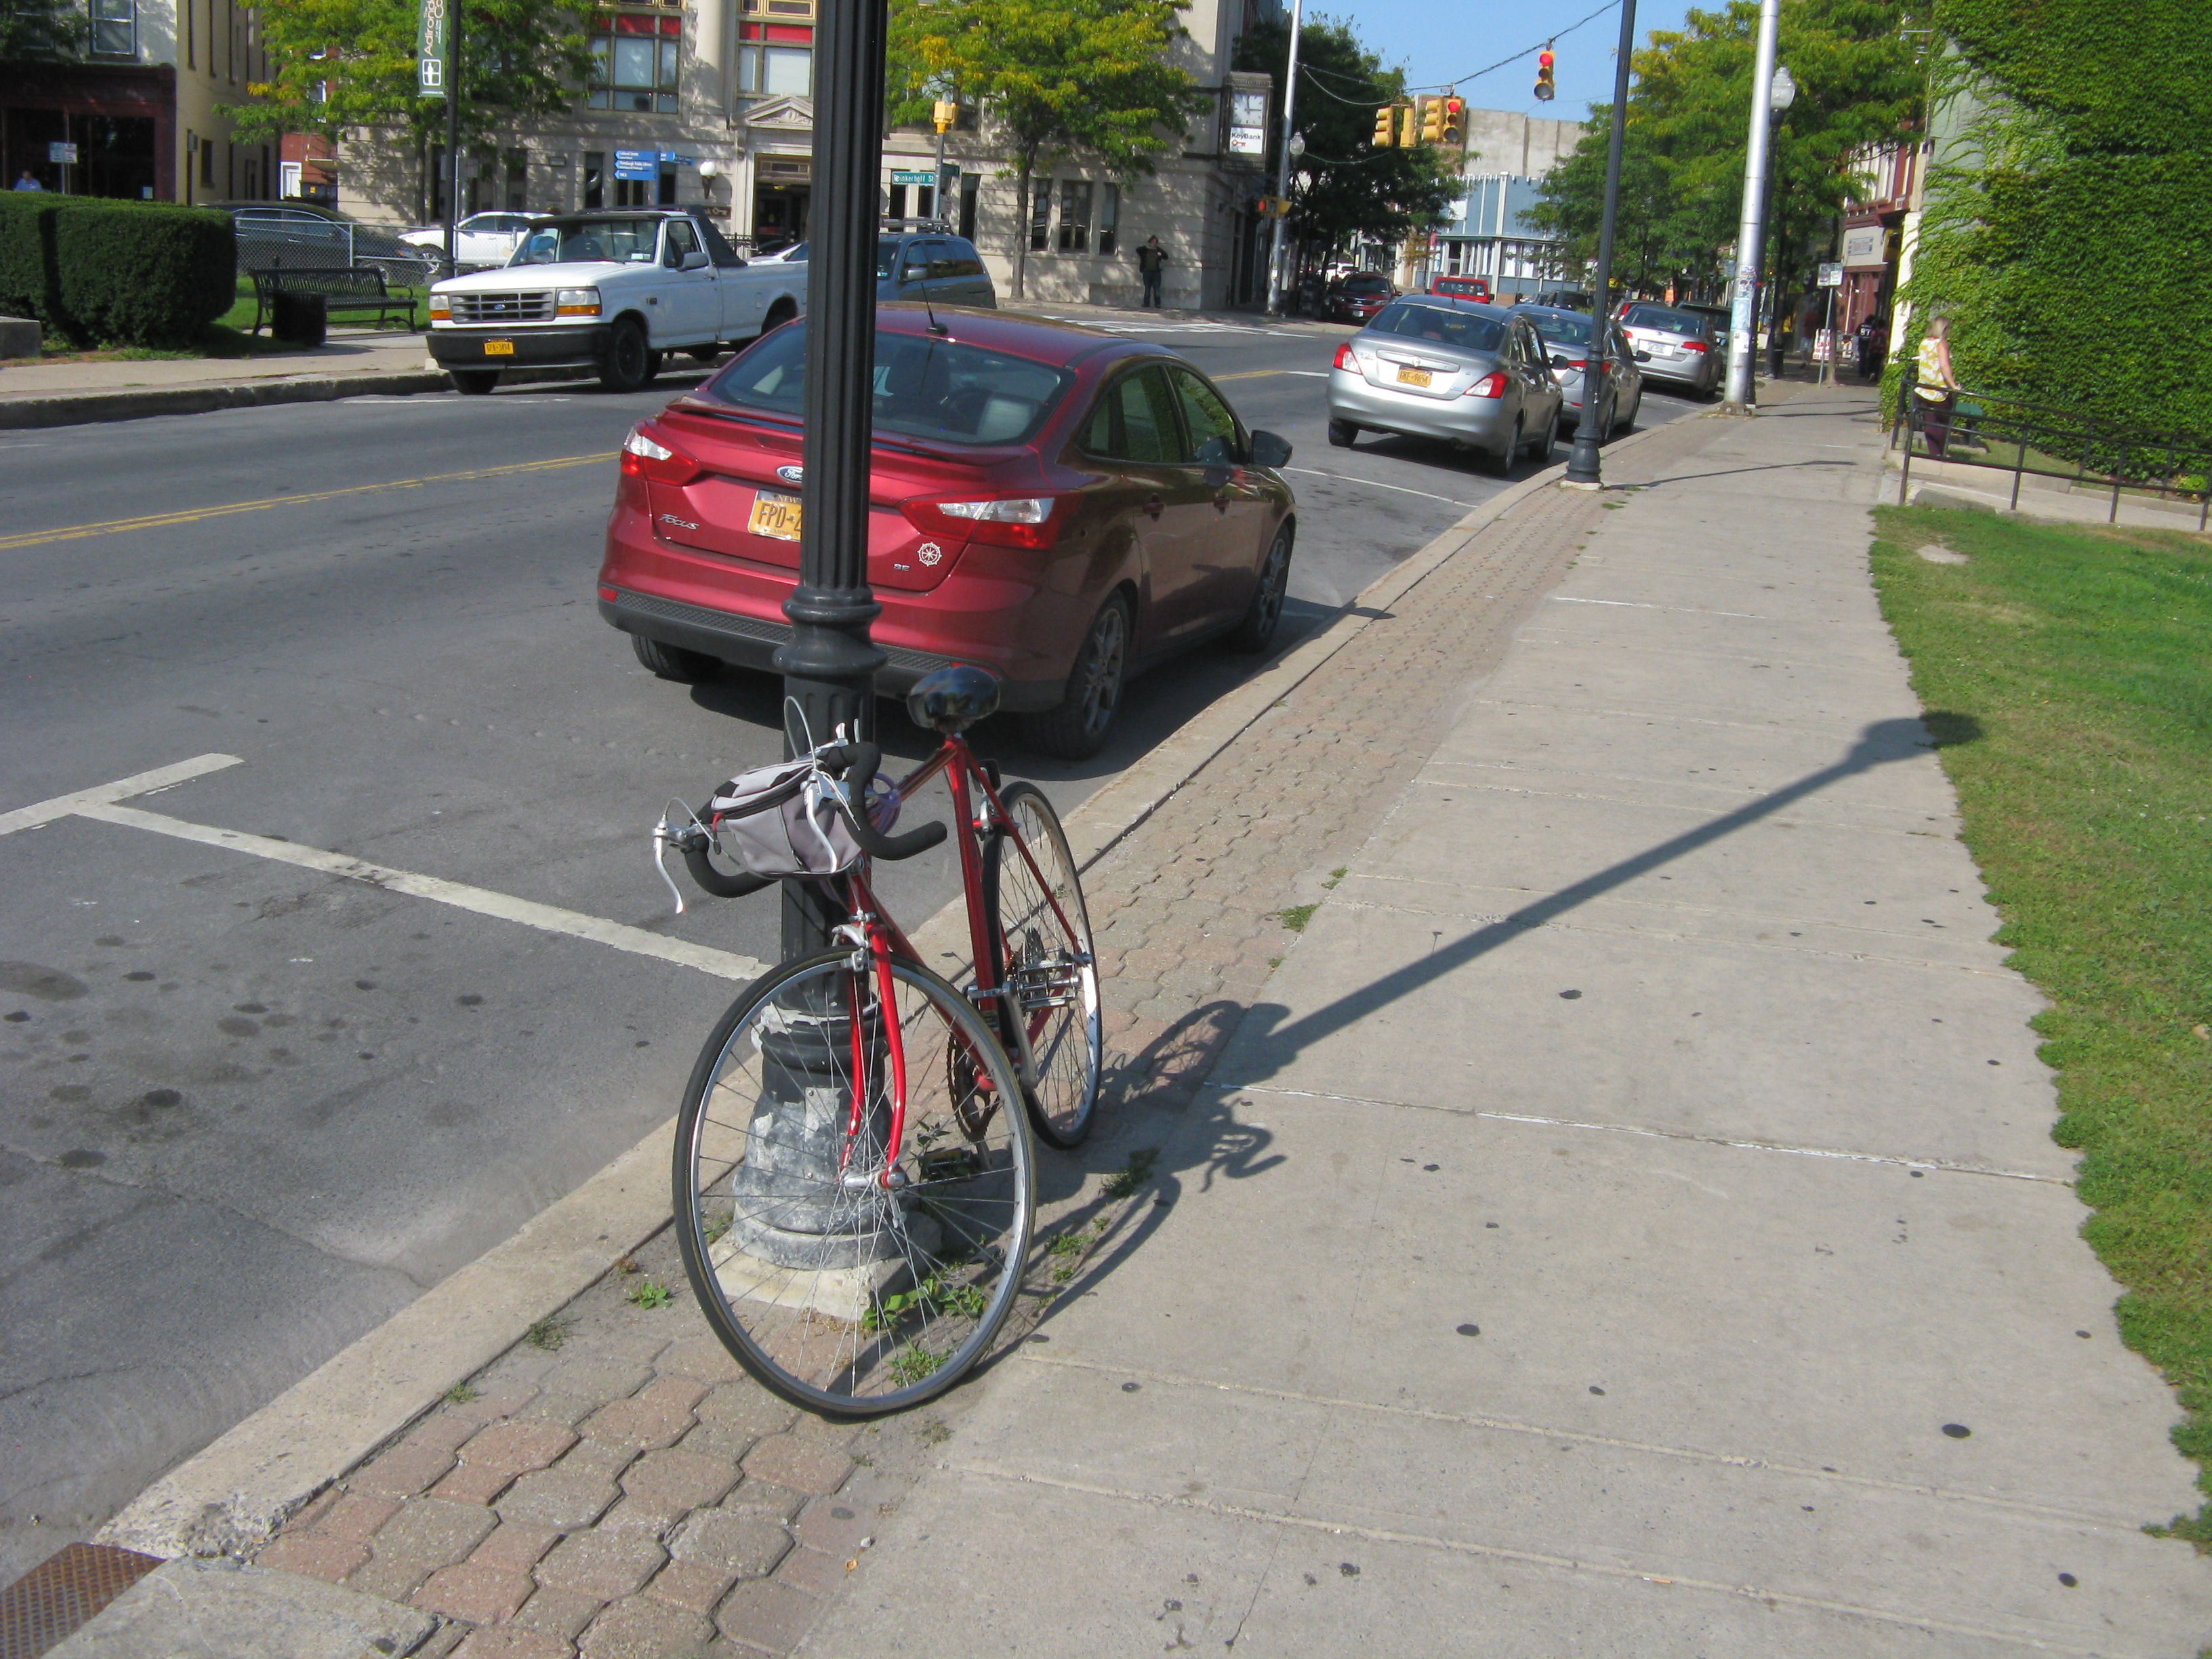
Observations
Few Bike Racks

Slide 22
Durkee St. Lot
289 Spaces
  Largest Single Parking Area
  Only Significant Public Parking
Development Opportunity
Will Change Downtown
Replace Existing Parking
Meet Future Parking Demand

Slide 23
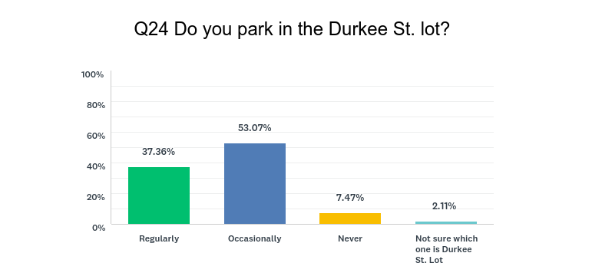
Durkee St. Lot

Slide 24
General Downtown Parking Needs
Adequate Parking Supply
  75% - 85% Occupancy Levels
  Regular Measurement
Ability to Support Development Opportunities
Available On-Street Parking
Well – Branded / Good Communication

Slide 25
Parking Decision Point
When Parking Occupancy Exceeds 70%
Choices
Build Enough Parking Supply So That It Doesn’t Have to Be Managed
Actively Manage Parking Supply

Slide 26
Laissez – Faire System
Must Overbuild by At Least 20%-30%
  Land Area Concerns
  Cost of Creating Parking Supply
Low Operating Costs
Can’t Add On-Street Spaces
Low Customer Service Levels
  First Come – First Serve – No Options
Requires Planning Consideration

Slide 27
Managed System
Overhead and Operating Costs
  Create Organizational Structure
  Capital Equipment
Maximize Parking Supply
Customer Service
  On-Street Strategy
  Employees
  Residential
Long Range Planning and Support DRI

Slide 28
What Parking Should Accomplish
Parking as Infrastructure / Utility
Plan for the Future
  Monitor Occupancy Levels
  Identify Future Parking Locations
  Support Development Plans
Maintain Customer Service Focus
Provide Options Through Pricing and Allocation

Slide 29
Effective Parking Program
Engaged Leadership
Sound Policy
  On-Street Parking
  Off-Street Parking
  Rates
  Enforcement
Based on Customer Service
Efficiency / Costs Monitored
Coordinated System

Slide 30
On-Street Parking
Important Ingredient in Effective Parking Systems
Most Visible and In – Demand Spaces
Meters / Time Limits Valuable Tools
  Provide Turnover of Parking Spaces
  High Level of Customer Service
Enforcement
  Consistent – Not Overbearing

Slide 31
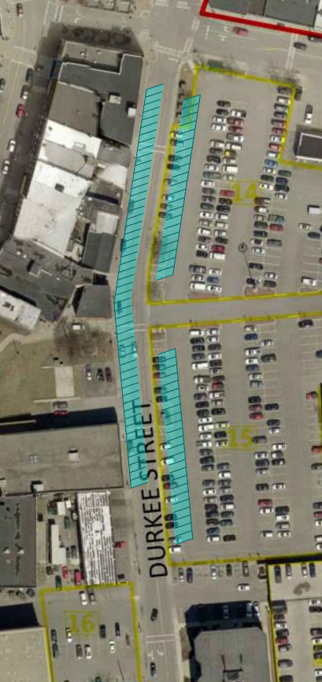
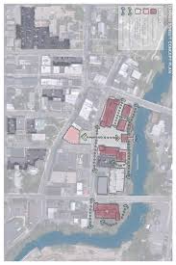
Options and Opportunities
Maximize Durkee St. Development
  Replace / Add Parking Supply on Site
  Require Necessary Spaces to Meet Development
  Add On-Street Spaces
    Net Gain of 60 - 75

Slide 32
Options and Opportunities
Can the Harbor Spaces Be Effectively Utilized?

Slide 33
Options and Opportunities
Create Parking
  Greenspace
  County Parking / Garages
  Demolish Condemned Buildings
  Shared Parking Arrangements w/ Private Owners

Slide 34
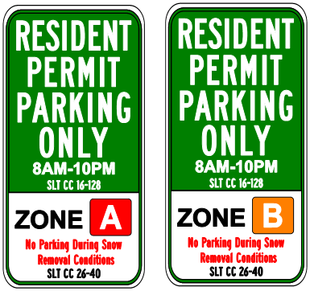
Options and Opportunities
Manage Parking System
Extended Time Limits On-Street
User Fees and Rates
  Customer Service
  Management Tool
  Assists in Paying Overhead
Residential Program

Slide 35
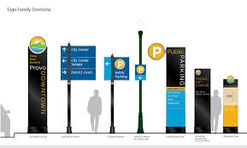

Options and Opportunities
Branding and Communication
  Signage and Wayfinding
  Online Presence
  Add Some
Adjust Parking Assessment District Policy
Promote Walking and Biking

Slide 36
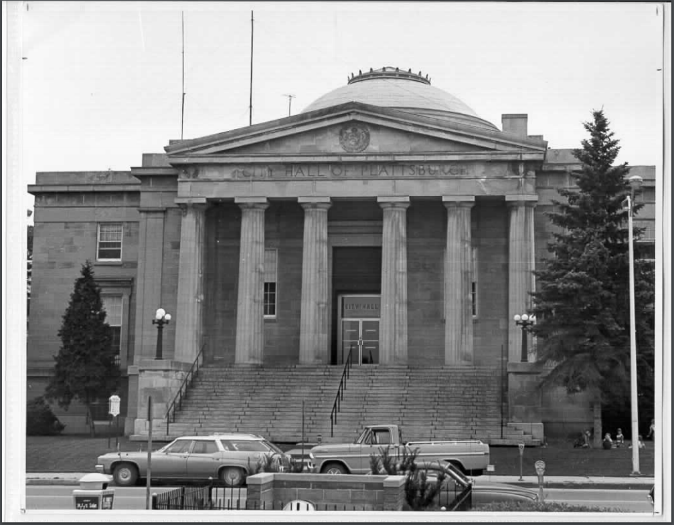
Options and Opportunities
Things Always Change – Response is Critical
When you're finished changing, you're finished.
Benjamin Franklin

Slide 37

Discussion

